Slide 1

Narrative AI Generation
By Isaac Dunn

Slide 2
Introduction
What is narrative AI
Types of narrative AI
How games use narrative AI

Slide 3
Aims and objectives
Aim to create a narrative AI with a cast character
Characters are able to talk to each other
Have actions and goals
Personality and emotion ai

Slide 4
Background
Why this project was chosen
Why it is important in games

Slide 5
Research methodology
Consider Waterfall vs Scrum
Scrum implementation

Slide 6
Project plan
Time scale (October – April)
Gantt chart

Slide 7
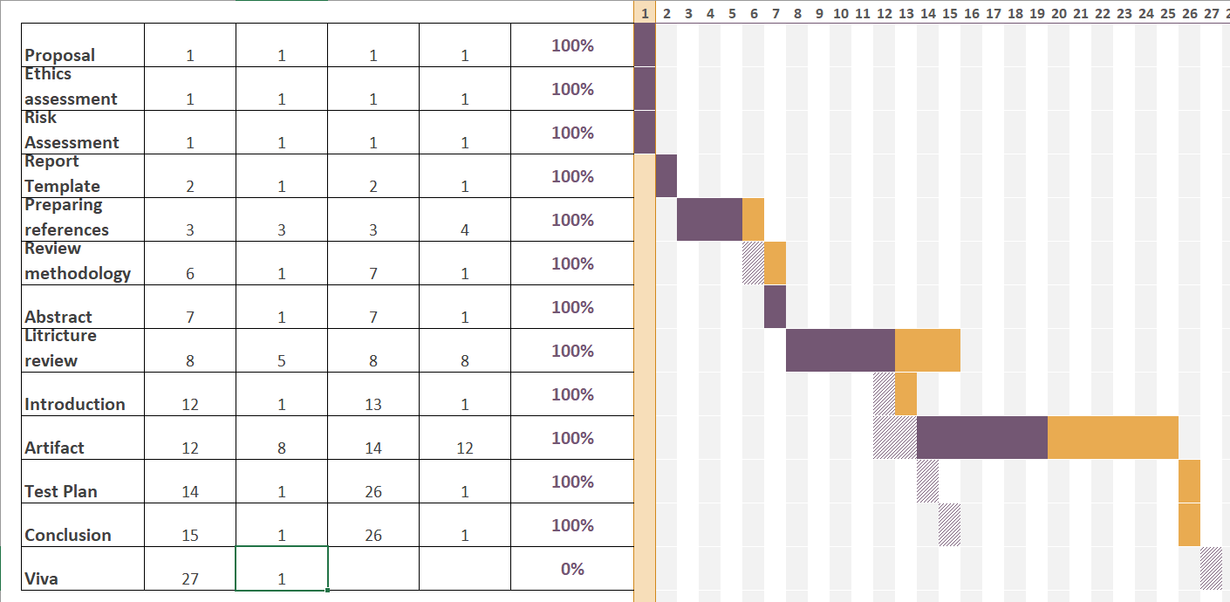
Project plan – Gantt

Slide 8

Analysis
C#
Unity

Slide 9
Implementation
Narrative Scaffolding
Natural Language Processing
Emotional AI
Personality System

Slide 10
Implementation – Narrative Scaffolding
Narrative Scaffolding
Natural Language Processing
Emotional AI
Personality System

Slide 11
Implementation - NLP
Narrative Scaffolding
Natural Language Processing
Emotional AI
Personality System

Slide 12
Implementation – Emotional AI
Narrative Scaffolding
Natural Language Processing
Emotional AI
Personality System

Slide 13
Implementation – Personality system
Narrative Scaffolding
Natural Language Processing
Emotional AI
Personality System

Slide 14
Testing
Test Log
Evaluation

Slide 15
Testing – Test Log
Test Log
Evaluation

Slide 16
Testing – Evaluation
Test Log
Evaluation

Slide 17
Results
Issues from test log
Issues with the project

Slide 18
Demo
Youtube link or game

Slide 19
Conclusion
What went well
What did not
What could be improved

Slide 20
Bibliography

